Slide 1
Random forest
What it is?
python implementation
Use cases

Slide 2
What it is
Random forest is solid choice for nearly any prediction problem (even non-linear ones).
It's a relatively new machine learning strategy (it came out of Bell Labs in the 90s) and it can be used for just about anything.
It belongs to a larger class of machine learning algorithms called ensemble methods.
Decision Trees
Bagging
Random Forest
Boosting

Slide 3
Ensemble Learning
involves the combination of several models to solve a single prediction problem.
It works by generating multiple classifiers/models which learn and make predictions independently.
Those predictions are then combined into a single (mega) prediction that should be as good or better than the prediction made by any one classifier.
Random forest is a brand of ensemble learning, as it relies on an ensemble of decision trees.
Ensemble learning – 2 types
Sequential
Parallel

Slide 4

How it works
Multiple decision trees
Outcome of all decision trees is taken and majority voting is the decision

Slide 5
How the Random Forest Algorithm Works
Pick N random records from the dataset. Build decision trees based on these N records.
Choose the number of trees you want in your algorithm and repeat steps 1 and 2.
In case of a regression problem, for a new record, each tree in the forest predicts a value for Y (output). The final value can be calculated by taking the average of all the values predicted by all the trees in forest.
Or,
in case of a classification problem, each tree in the forest predicts the category to which the new record belongs.
Finally, the new record is assigned to the category that wins the majority vote.

Slide 6
Basically …
Random Forest – consists of multiple decision trees
Build trees randomly – Data, Features
2 steps
Step 1 - Pick data randomly with replacement (Bagging or Bootstrap aggregation) for each tree
Same data may be picked again
Choosing N samples out of n samples
Choose M features out of p variables
Step 2 – Execute the estimators. idea of averaging
10 split points
For each split, evaluate the IG or Gini
Random Forests algorithm is a classifier based on primarily 2 methods –
bagging and
random subspace method.

Slide 7
bagging
training data set is represented by D and suppose data set has M features (or attributes or variables).
D = {(X₁, y₁), (X₂, y₂), ... (X_{n}, y_{n})}
X_{i} is input vector {x_{i1}, x_{i2}, ... x_{iM}} and y_{i} is the label (or output or class).
we decide to have T number of trees in our forest
Draw T, number of bootstrap samples D¹, D² …. , D^{T} from original data D
datasets of "same size as original" created from random resampling of data in D with-replacement
Each of these is called a bootstrap dataset. Due to "with-replacement" every dataset D_{i} can have duplicate data records and D_{i} can be missing several data records from original datasets.
Training sample: 1, 2, 3
First bootstrap sample: 1, 1, 2
Second bootstrap sample: 2, 3, 3

Slide 8
random subspace method.
attribute bagging or feature bagging
RF creates T trees and uses m (=sqrt(M) or = floor(ln^{M+1})) random sub features out of M possible features to create any tree.
This is called random subspace method.

Slide 9
questions
How can we combine, Decision functions for regression?
Binary class predictions, Binary probability predictions, Multi-class predictions
Let f1, f2, …, fB be the decision functions for each set
the bagged decision function is a combination of these:
favg(x) = combine(f1(x), f2(x), …. , fB(x))
to classify some input data D = {x1, x2, ..., xM} , let it pass through each tree and produce T outputs (one for each tree) which can be denoted by Y = {y₁, y₂, ..., y_{T}}.
Final prediction is a majority vote on this set.

Slide 10
So ..
Decisions are made at each tree (at the leaf node by default, or it can be made at an intermediate level as well)
Averaging of decisions
Each tree gets to see subset of data and features.
Each tree gives different result.
Hence there is very possibility of HIGH VARIANCE model. So how is it that RF is considered the most favored model?
The idea is that each tree is random and hence their outcomes will vary.
The assumption is that the variables aren’t corelated, hence their decisions will be random
And the averaging of decisions will lead to better performance of the mode.
If the variables are co-related then RF will not help much

Slide 11
Out-of-bag
D dataset, T trees,
for each (X_{i}, y_{i}) in the original training set i.e. D, select all D_{k} which does not include (X_{i}, y_{i}).
The set of bootstrap datasets which do not contain THE particular record from the original dataset. This is called out-of-bag example.
There are n such subsets (1 for each data record in original dataset D).
OOB classifier is the aggregation of votes ONLY over Tk such that it does not contain (xi, yi).
Out-of-bag estimate for the generalization error is the error rate of the out-of-bag classifier on the training set (compare it with known yi's).
63% and 37% …

Slide 12


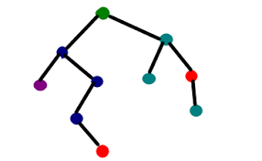
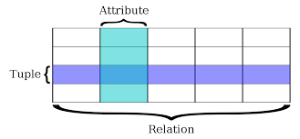
Out-of-bag
D dataset , not containing Xi T, trees
D1
T1
MAJORITY VOTING
D1, D5, D11
T1, T5, T11
D9, D5, D21
T9, T5, T21
D2
T2
D11, D15, D19
T11, T15, T19
D
D3
T3
…
…
…
D25
T25
D14, D25, D16
T14, T25, T16

Slide 13
OOB vs. Test Partition Performance
every tree in the forest is built on about 63% of the available data, leaving the remaining approximately 37% for testing [the OOB (out-of-bag) data].
This 37% OOB data is not fixed, this is actually those 37% that a particular estimator has not seen it !!
So the OOB data will be different for each estimator, but it will roughly be 37%
the number of trees = 500
on average a record will be OOB for about .37*500=185 trees
use just these trees to generate predictions.
This allows the RandomForestClassifier to be fit and validated whilst being trained
OOB predictions are based on a rather small subsample of the trees

Slide 14
Why OOB is important?
Internal testing while training
The study of error estimates for bagged classifiers in Breiman [1996b], gives empirical evidence to show that the out-of-bag estimate is as accurate as using a test set of the same size as the training set.
Therefore, using the out-of-bag error estimate removes the need for a set aside test set.
Gives early indication of how good is the classifier (RF)
Possibly
No need for cross validation (CV) or separate test

Slide 15
sklearn.ensemble.RandomForestClassifier
# instantiate the RF classifier
# Set the random state for reproducibility
clf = RandomForestClassifier(random_state=42)
class sklearn.ensemble.RandomForestClassifier(n_estimators=10, criterion=’gini’, max_depth=None, min_samples_split=2, min_samples_leaf=1, min_weight_fraction_leaf=0.0, max_features=’auto’, max_leaf_nodes=None, min_impurity_decrease=0.0, min_impurity_split=None, bootstrap=True, oob_score=False, n_jobs=1, random_state=None, verbose=0, warm_start=False, class_weight=None)[source]

Slide 16
n_estimators
is the number of trees in the forest.
The larger the better, but also the longer it will take to compute.
In addition, note that results will stop getting significantly better beyond a critical number of trees.
Default = 10

Slide 17
max_features
is the size of the random subsets of features to consider when splitting a node.
The lower, the greater the reduction of variance,
Empirical good default values are
max_features=n_features for regression problems,
max_features=sqrt(n_features) for classification tasks
(where n_features is the number of features in the data).
If int, then consider max_features features at each split.
If float, then max_features is a percentage and int(max_features * n_features) features are considered at each split.
If “auto”, then max_features=n_features.
If “sqrt”, then max_features=sqrt(n_features).
If “log₂”, then max_features=log₂(n_features).
If None, then max_features=n_features.

Slide 18
max_depth
The maximum depth of the tree.
integer or None, optional (default=None)
If None, then nodes are expanded until all leaves are pure or until all leaves contain less than min_samples_split samples.

Slide 19
min_samples_split
The minimum number of samples required to split an internal node:
int, float, optional (default=2)
If int, then consider min_samples_split as the minimum number.
If float, then min_samples_split is a percentage and ceil(min_samples_split * n_samples) are the minimum number of samples for each split.

Slide 20
warm_start
class sklearn.ensemble.RandomForestClassifier(n_estimators=10, criterion=’gini’, max_depth=None, min_samples_split=2, min_samples_leaf=1, min_weight_fraction_leaf=0.0, max_features=’auto’, max_leaf_nodes=None, min_impurity_decrease=0.0, min_impurity_split=None, bootstrap=True, oob_score=False, n_jobs=1, random_state=None, verbose=0, warm_start=False, class_weight=None)[source]
Add the explanation …

Slide 21
oob_score
oob_score : bool (default=False)
Whether to use out-of-bag samples to estimate the generalization accuracy.

Slide 22
Application of random forest
Banking | Medicine | Stock Market | E-commerce
loyal customer | identify the correct combination of the components to validate the medicine | identify the stock behavior as well as the expected loss or profit by purchasing the particular stock. | recommendation engine for identifying the likely hood of customer liking the recommend products base on the similar kinds of customers.
finding the fraud customers.
Running random forest algorithm on very large dataset requires high-end GPU systems.

Slide 23
Attributes
estimators_ : The collection of fitted sub-estimators.
classes_ : [n_classes] or a list of such arrays
n_classes_ : The number of classes
n_features_ : The number of features when fit is performed.
n_outputs_ : The number of outputs when fit is performed.
feature_importances_ : Return the feature importance (the higher, the more important the feature).
oob_score_ : Score of the training dataset obtained using an out-of-bag estimate.
oob_decision_function_ : Decision function computed with out-of-bag estimate on the training set.

Slide 24
Advantages of using Random Forest
The random forest algorithm is not biased, since, there are multiple trees and each tree is trained on a subset of data. overall biasedness of the algorithm is reduced.
The overfitting problem will is reduced.
Even if a new data point is introduced in the dataset the overall algorithm is not affected much since new data may impact one tree, but it is very hard for it to impact all the trees.
The random forest algorithm works well when you have both categorical and numerical features.
can be used for feature engineering.
Can be used for both classification and regression task

Slide 25
Disadvantages of using Random Forest
A major disadvantage of random forests lies in their complexity.
Require much more computational resources, owing to the large number of decision trees joined together.
Due to their complexity, it requires much more time to train than other comparable algorithms.

Slide 26
benefits
No overfitting
Use of multiple trees to reduce the risk of overfitting
Training time is less
High accuracy wrt the BIG DATA
Estimates missing data

Slide 27
Boosting
Gradient boost
XG boost

Slide 28
What is gradient boosting
Gradient Boosting = Gradient Descent + Boosting
Let’s play a game... You are given (x1, y1),(x2, y2), ...,(xn, yn), and the task is to fit a model F(x) to minimize square loss. Suppose your friend wants to help you and gives you a model F. You check his model and find the model is good but not perfect.
There are some mistakes: F(x1) = 0.8, while y1 = 0.9,
and F(x2) = 1.4 while y2 = 1.3...
How can you improve this model?
Rule of the game: I You are not allowed to remove anything from F or change any parameter in F
You can add an additional model (regression tree) h to F, so the new prediction will be F(x) + h(x).

Slide 29
Mathematically:
Simple solution: You wish to improve the model such that
F(x1) + h(x1) = y1
F(x2) + h(x2) = y2 ...
……
F(xn) + h(xn) = yn
The same can be modified as :
h(x1) = y1 − F(x1)
h(x2) = y2 − F(x2) ...
…..
h(xn) = yn − F(xn)
Can any regression tree h achieve this goal perfectly? Maybe not.... But some regression tree might be able to do this approximately. How? Just fit a regression tree h to data (x1, y1 − F(x1)),(x2, y2 − F(x2)), ...,(xn, yn − F(xn))

Slide 30
yi − F(xi) are called residuals. These are the parts that existing model F cannot do well.
The role of h is to compensate the shortcoming of existing model F.
If the new model F + h is still not satisfactory, we can add another regression tree...
We are improving the predictions of training data, is the procedure also useful for test data?
Yes! Because we are building a model, and the model can be applied to test data as well.
How is this related to gradient descent?

Slide 31
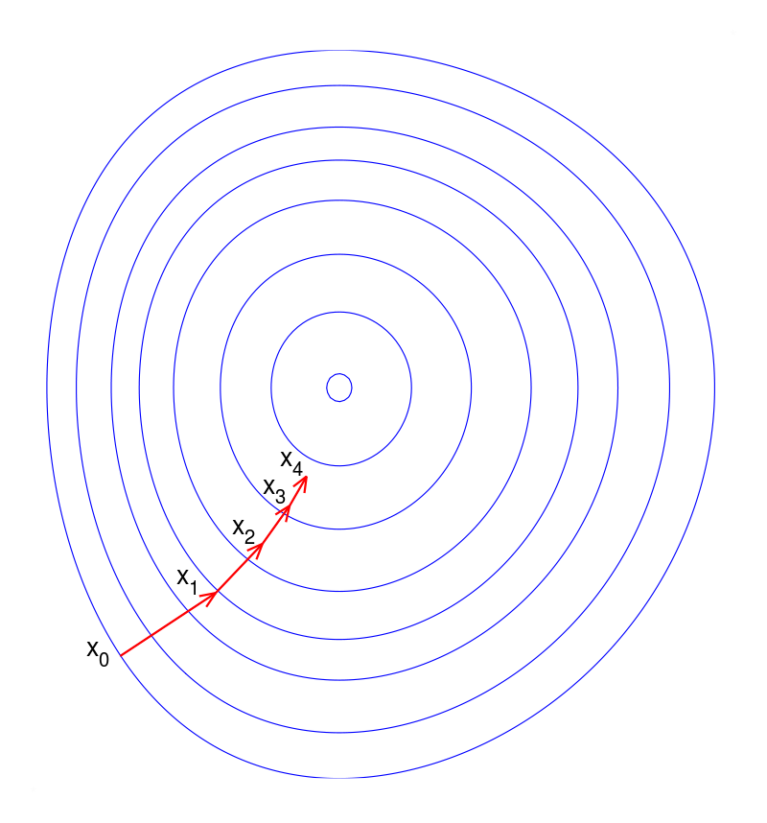
Gradient Descent Minimize a function by moving in the opposite direction of the gradient.
θi := θi − ρ (∂J/ ∂θi)
https://en.wikipedia.org/wiki/Gradient_descent

Slide 32
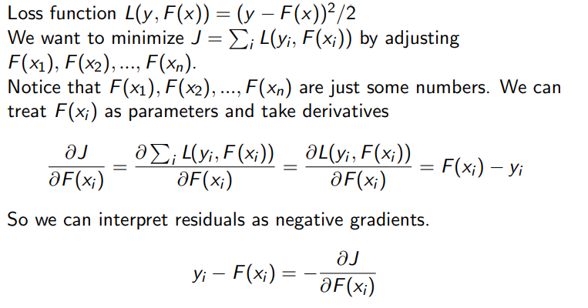

Slide 33
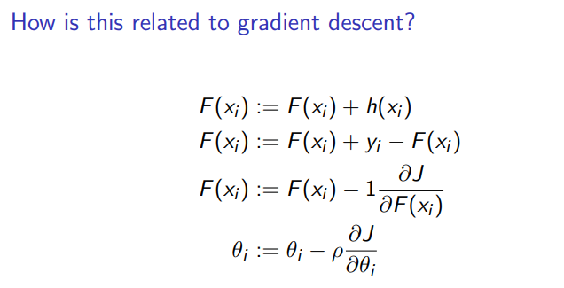

Slide 34
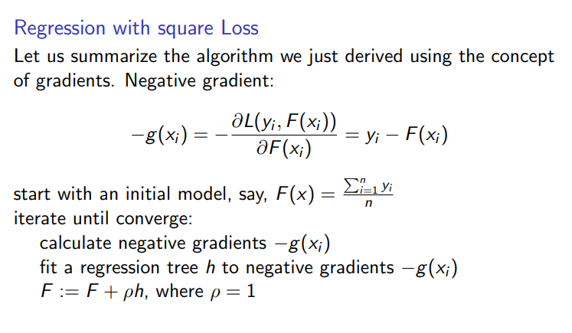
The benefit of formulating this algorithm using gradients is that it allows us to consider other loss functions and derive the corresponding algorithms in the same way.

Slide 35
How is this related to gradient descent?
For regression with square loss,
residual ⇔ negative gradient
fit h to residual ⇔ fit h to negative gradient
update F based on residual ⇔ update F based on negative gradient
So we are actually updating our model using gradient descent!
It turns out that the concept of gradients is more general and useful than the concept of residuals.
So from now on, let’s stick with gradients. The reason will be explained later.

Slide 36
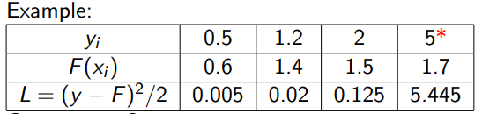
Loss functions for Regression Problem
Square loss is:
Easy to deal with mathematically
Not robust to outliers Outliers are heavily punished because the error is squared. Pay too much attention to outliers. Try hard to incorporate outliers into the model. Degrade the overall performance.

Slide 37
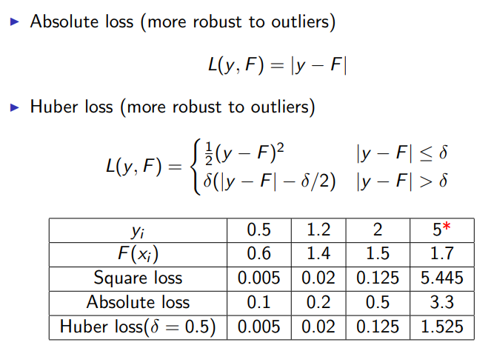

Slide 38
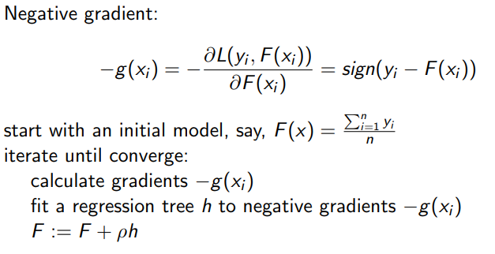
Regression with absolute loss

Slide 39
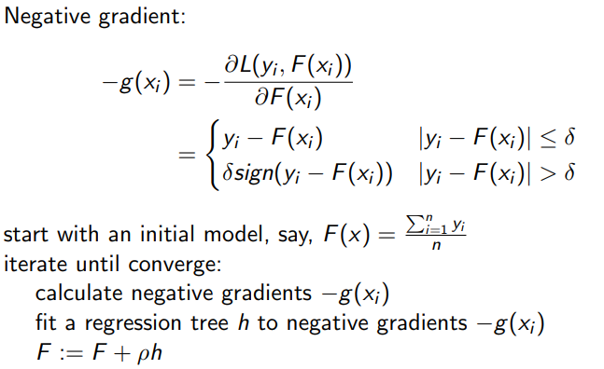
Regression with huber loss

Slide 40
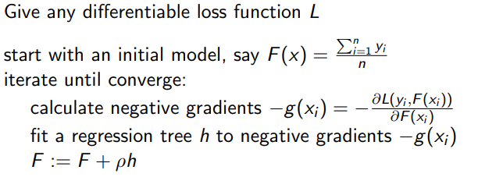
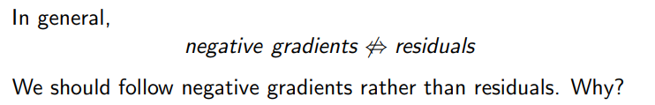
Regression with loss function L: general Procedure

Slide 41

Fit an additive model F in a forward stage-wise manner.
In each stage, introduce a new regression tree h to compensate the shortcomings of existing model.
The“shortcomings” are identified by negative gradients.
For any loss function, we can derive a gradient boosting algorithm.
Absolute loss and Huber loss are more robust to outliers than square loss.

Slide 42
Gradient boost for Regressionn
Position | Level | Salary
Business Analyst | 1 | 45000
Junior Consultant | 2 | 50000
Senior Consultant | 3 | 60000
Manager | 4 | 80000
Country Manager | 5 | 110000
Region Manager | 6 | 150000
Partner | 7 | 200000
Senior Partner | 8 | 300000
C-level | 9 | 500000
CEO | 10 | 1000000
Step1: initializing with constant value arrives from derivative of loss function
Step2: calculate the residuals.
Step3: construct Decision Tree based on residuals

Slide 43
Gradient Boosting for classification
Problem Recognize the given hand written capital letter.
Multi-class classification
26 classes. A,B,C,...,Z
Feature Vector= (2, 1, 3, 1, 1, 8, 6, 6, 6, 6, 5, 9, 1, 7, 5, 10) Label = G

Slide 44
Feature extraction
Data set : http://archive.ics.uci.edu/ml/datasets/Letter+
1 horizontal position of box
2 vertical position of box
3 width of box 11 mean of x * x * y
4 height of box
5 total number on pixels
6 mean x of on pixels in box
7 mean y of on pixels in box
8 mean x variance
9 mean y variance
10 mean x y correlation
12 mean of x * y * y
13 mean edge count left to right
14 correlation of x-ege with y
15 mean edge count bottom to top
16 correlation of y-ege with x

Slide 45
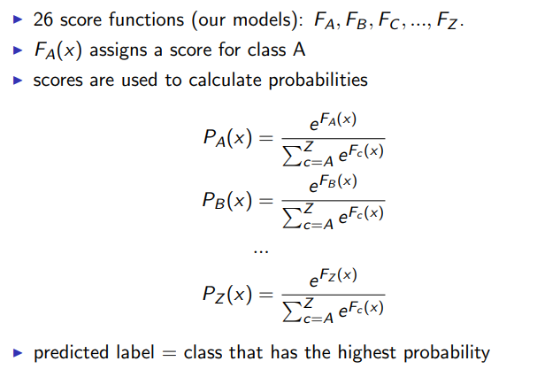

Slide 46
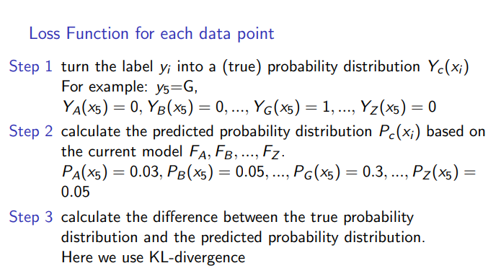

Slide 47
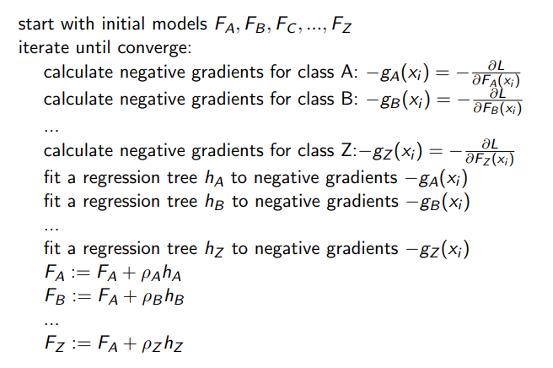

Slide 48
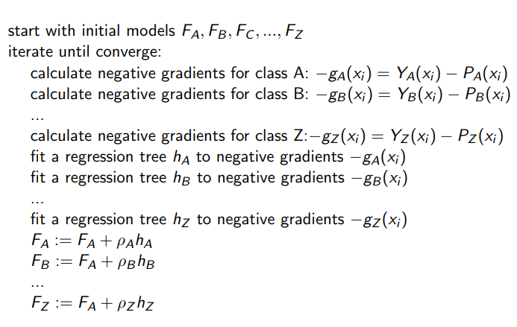

Slide 49
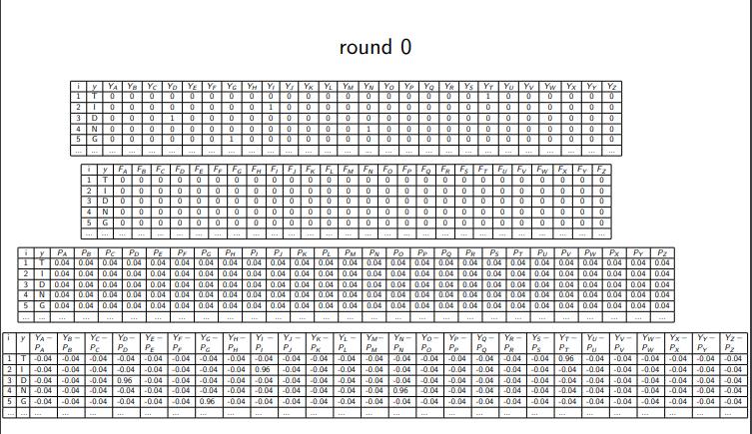

Slide 50
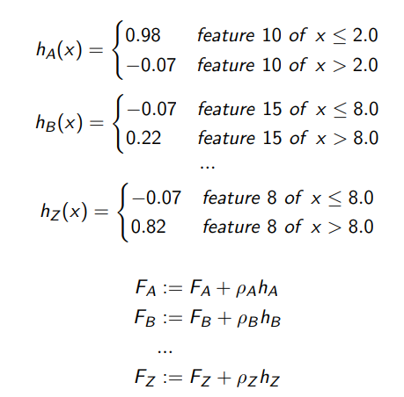

Slide 51
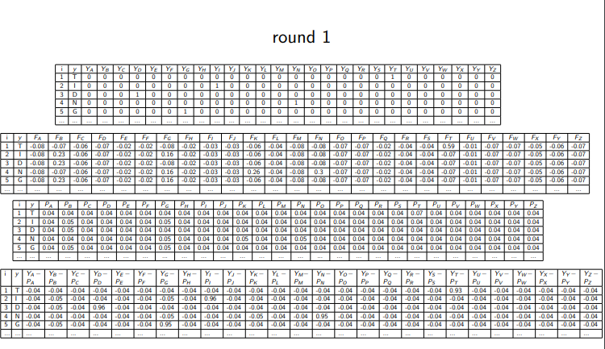

Slide 52
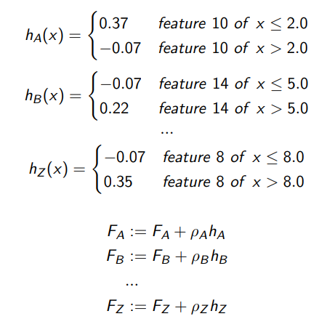

Slide 53
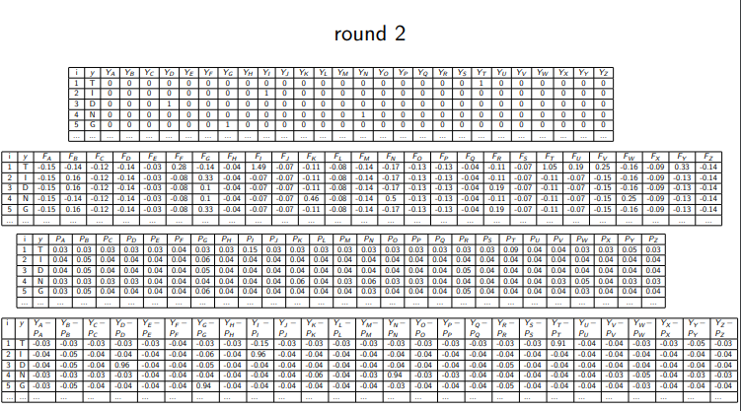

Slide 54
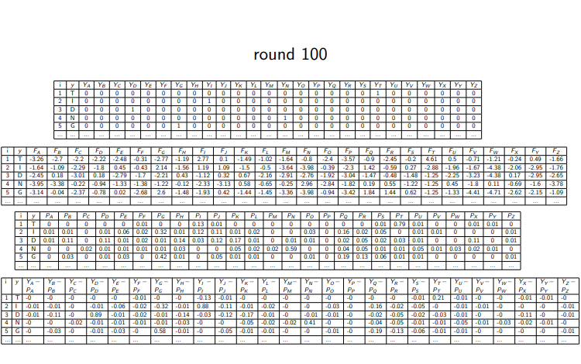

Slide 55
XG-Boost
XG-Boost : Extreme Gradient Boosting Algorithm
XGBoost was developed by Tianqi Chen and collaborators for speed and performance
XGBoost is an implementation of gradient boosted decision trees designed for speed and performance.

Slide 56
Parallel Computing: It is enabled with parallel processing (using OpenMP); i.e., when you run xgboost, by default, it would use all the cores of your laptop/machine.
Regularization: I believe this is the biggest advantage of xgboost. GBM has no provision for regularization. Regularization is a technique used to avoid overfitting in linear and tree-based models.
Enabled Cross Validation: In R, we usually use external packages such as caret and mlr to obtain CV results. But, xgboost is enabled with internal CV function (we'll see below).
Missing Values: XGBoost is designed to handle missing values internally. The missing values are treated in such a manner that if there exists any trend in missing values, it is captured by the model.
Flexibility: In addition to regression, classification, and ranking problems, it supports user-defined objective functions also. An objective function is used to measure the performance of the model given a certain set of parameters. Furthermore, it supports user defined evaluation metrics as well.
Availability: Currently, it is available for programming languages such as R, Python, Java, Julia, and Scala.
Save and Reload: XGBoost gives us a feature to save our data matrix and model and reload it later. Suppose, we have a large data set, we can simply save the model and use it in future instead of wasting time redoing the computation.
Tree Pruning: Unlike GBM, where tree pruning stops once a negative loss is encountered, XGBoost grows the tree upto max_depth and then prune backward until the improvement in loss function is below a threshold

Slide 57
XG Boost Regression
All residual will be stores as leaf
Calculating similarity score for the residuals. Summation of residual square divided by summation of number of residual and the regularization
Similarity score= ∑ (y-ypred)**2/ number of residuals + lambda
Here lambda is regularization parameter
Consider average to decide the split point. Values less than split point should be at left and values greater than split point is at right side. Again calculate the
Calculate the Gain = Left similarity score + Right similarity score - Root
In the same way we will calculate the for every branch in the tree.
Once calculation for done till the depth, we can think about the pruning.
If the difference between gain and gamma is negative we will remove the branch otherwise keep the branch.

